Slide 1
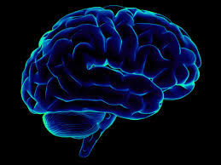

Practicum Presentation - 1
Apple INC
Practicum-1
Group Members
Atul Sharma (11810126)
Sandeep Kumar Singh (11810014)

Slide 2
Agenda
Executive Summary (Practicum Extract)
Business Problem
Data Requirements & Data Collections
Data Understanding
Data Preparation
Modeling and Evaluation
Google Trends
Conclusion
Demo Video

Slide 3
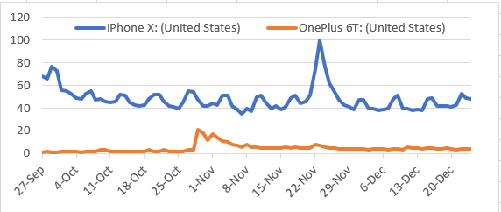
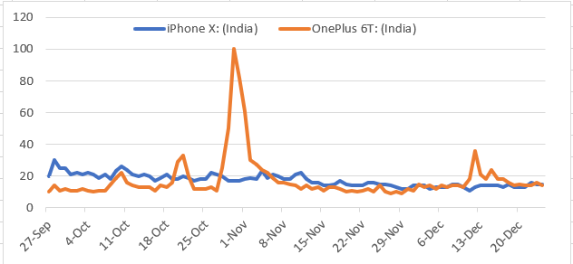
Executive Summary (Abstract)
Motivation: Is apple losing the sheen? Apple’s loyal base and services used to be best in industry and due to recent events seems apple users are moving away. To understand this we want to analyse the popularity, perception and sentiment through data from various sources
Method: We have picked iPhone X which is a flagship product. To analyse we have used twitter data (tweets contain iPhone X) along with data from Kaggle. Amazon Kaggle data contains review about all unlocked phones and apart from this we have used iPhone review data as well. To train the model (logistics regression) we have used unlocked phone data and tested it against iPhone X reviews to find the sentiment. Once done, we have populated word cloud to find other most frequent words. Same thing (test against model and plotting the sentiment) was done with twitter data after merging and cleaning.
Models: we have used logistics regression model based on Bag of words vectorization method. For training this model we have used unlocked phones data and tested it against review data and twitter data. We found that positive perception regarding iPhone X has not changed since last year (review data is from last December and twitter data from this December). People talk about other phones along with iPhone but mostly for comparison.
Message: Overall with this analysis we were able to find that people have positive sentiment regarding iPhone X. Popularity of apple products most specifically iPhone is very good. There was a spike in Aug and Nov(4 days black Friday event). If we compare OnePlus 6T against iPhone X, iPhone is still a winner. This trend reverses in India where iPhone is not so popular against OnePlus or Samsung.
Google Trends:
Means: visualization: Matplotlib, wordcloud, Data Pull: csv, xml, tweepy, numpy, pandas, Modelling: scikit-learn, textblob, language: python

Slide 4
Business Problem
Business Understanding
Is Apple still the greatest tech company that it used to be? Investors are concerned. Is Apple’s loyal fan base diminishing in size? US market hardly gives any growth to Apple. OnePlus is dominating Apple in key emerging markets. Is there a paradigm shift in the user sentiment of Apple? How about investor sentiment? These are the question which we are trying to answer with our analysis.
Analytics Approach
Collection of historical data related to other products including iPhone. (historical trend)
Collection of iPhone X reviews (product specific perception of users) and twitter data (general perception of users)
Training the model with historical data and testing it with review data along with tweeter data
Finding the popularity of chosen products in text corpus
Discussion on final outcome
Through this analysis, we would like to have a directional sense to understand the current business problem in systematic manner. Corrective measure should be in place if there are major deviation

Slide 5
Data Requirements & Collections
Data Requirements
We required historical data as well as current data to find out the past and present sentiment.
We required Google Trends to analysis the sentiments/popularity over a period of time.
We required historical data to train the Model and current data to test the Model
Data Collections
To conduct the study, we have to gather the data from different sources: Google Trends, Twitter, Kaggle
The twitter data is important as we need to test our model. We have to get through Twitter API key, we have collected the data in small chunks to make it large enough for testing
Google Trends is good directional indicator. The data is fairly clean and available
Kaggle review data set will help in training the Model.
Challenges:
Twitter API Access: Twitter initially denied providing us keys. They did not allow until we have used ISB email to create a new twitter account but it was very late and we could not pull 10K records but we still managed to pull more than 7K
Selecting the Historical data: We explore multiple data sources to select the right data set for this study

Slide 6
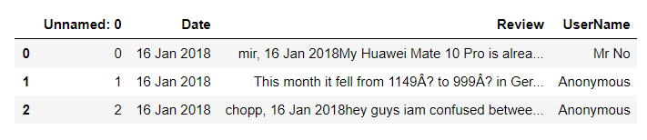
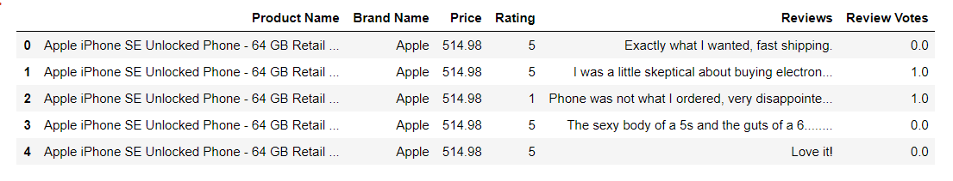
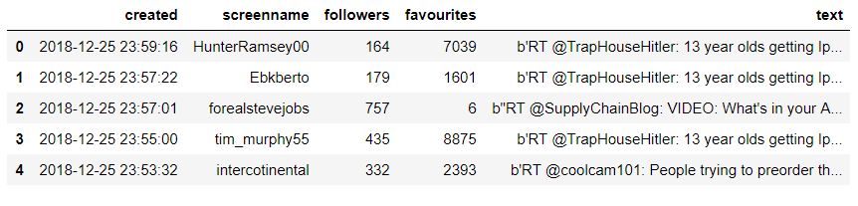
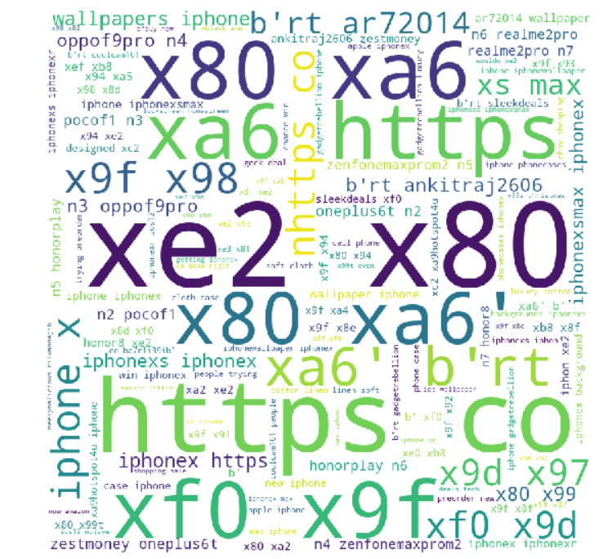
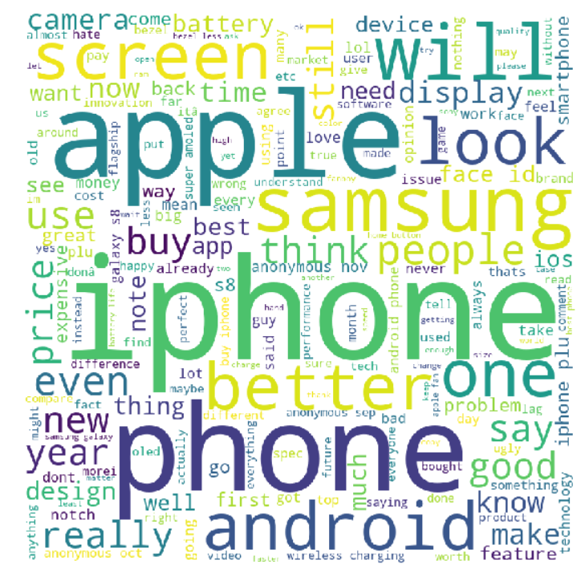
Data Understanding
Data Summary (left to right- iPhone X review, all unlocked phones review, twitter data)
First Cut Analysis & Initial Patterns (word cloud twitter, review)

Slide 7
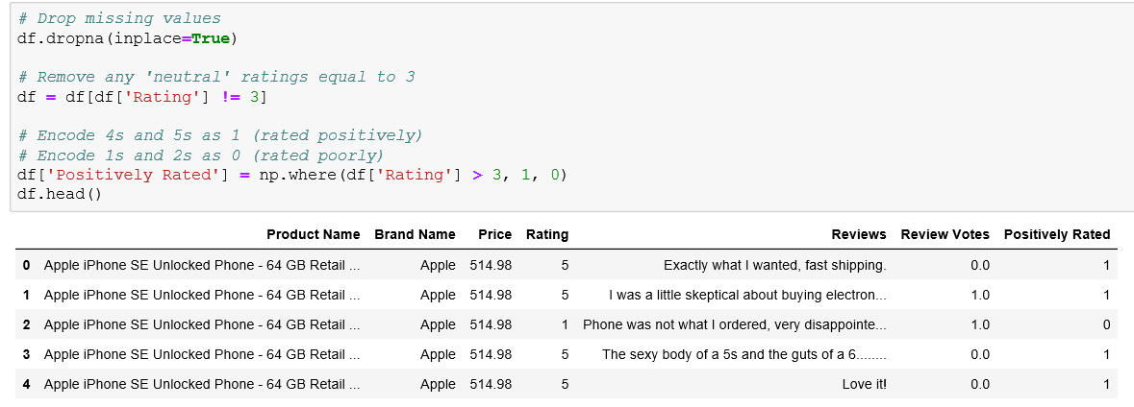
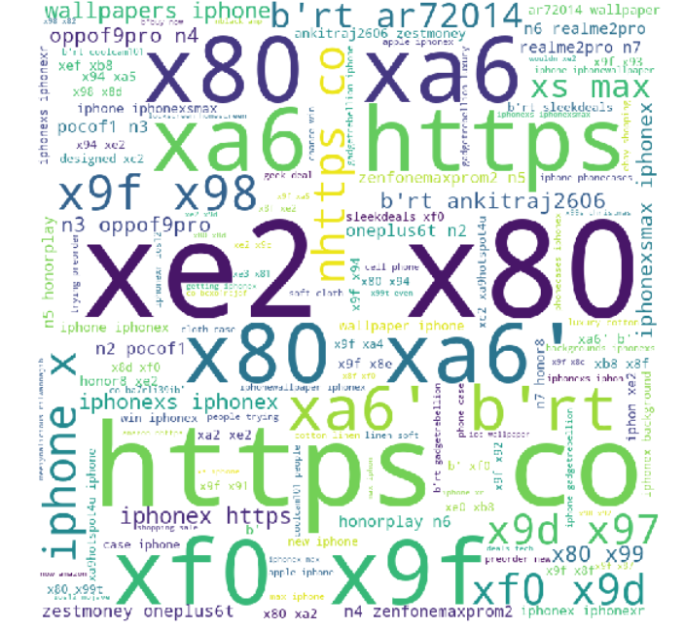
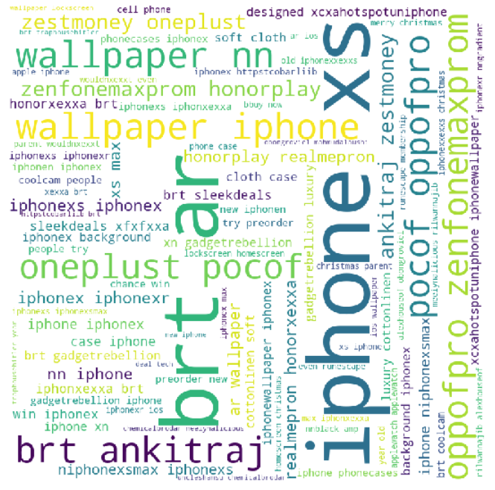
Data Preparation
We faced majorly three problems while preparing the data for this study:
Missing Value: While collecting the data, we found out lot of missing values and when we analysis the complete data set, we conclude that we will remove/drop the missing values from the dataset.
Neutral Rating: Dealing with Neutral rating in our data set is important to clearly define the positive and negative ratings. We removed all the neutral rating and converted all positive to 1 and all negative to 0
Before Cleaning Junk Data
After Cleaning Junk Data
Junk Data: Twitter extract lot of junks, where we have to clean the data to prepare for testing.

Slide 8
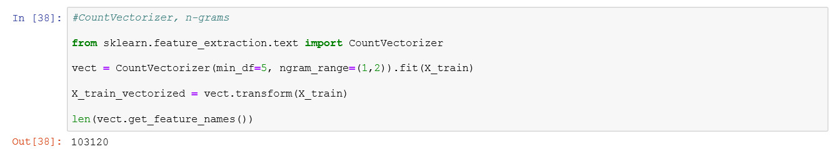
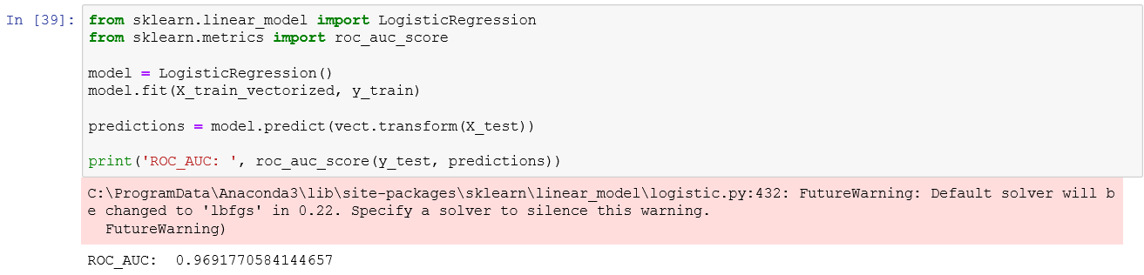
Modeling and Evaluation
We have used logistics regression model based on Bag of words vectorization method. For training this model we have used unlocked phones data and tested it against review data and twitter data. We found that positive perception regarding iPhone X has not changed since last year (review data is from last December and twitter data from this December). People talk about other phones along with iPhone but mostly for comparison.
Bags-of-words:
We have used bag of words method to find out frequency of each word in the whole structure. Count Vectorizer provides us tokens based on text data we have provided
Logistic Regression:
Based on feature matrix X_ train_ vectorized we train the Logistic Regression classifier because Logistics Regression works well for high dimensional sparse data.

Slide 9
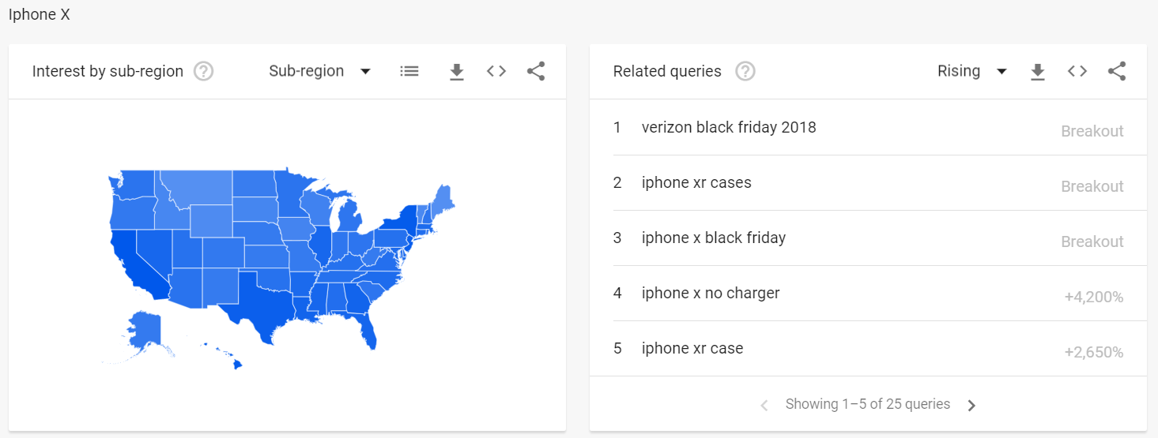
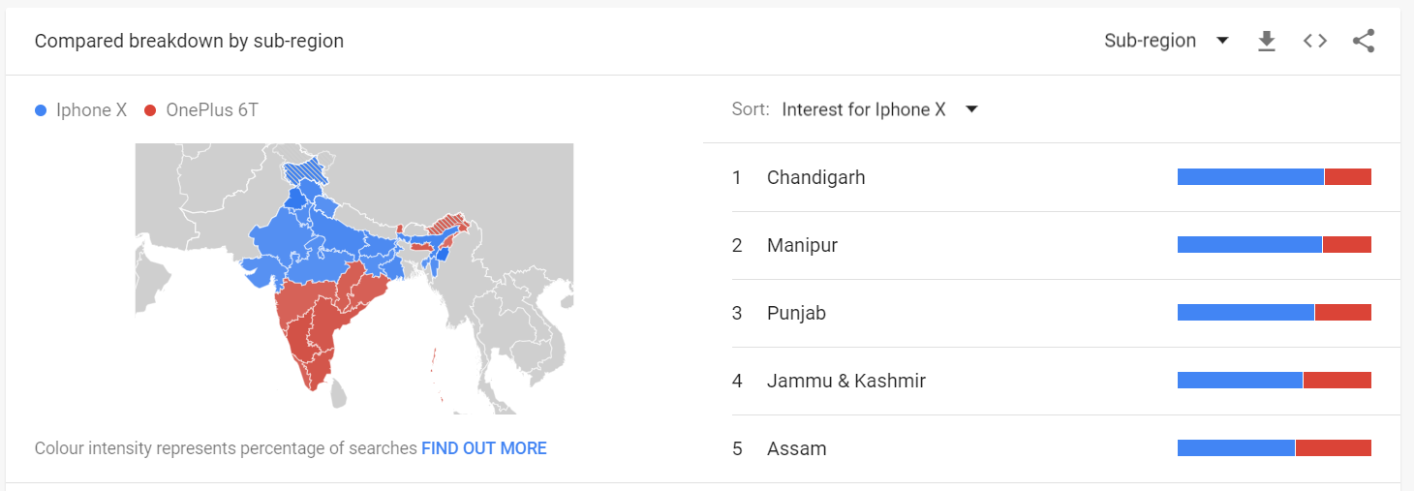
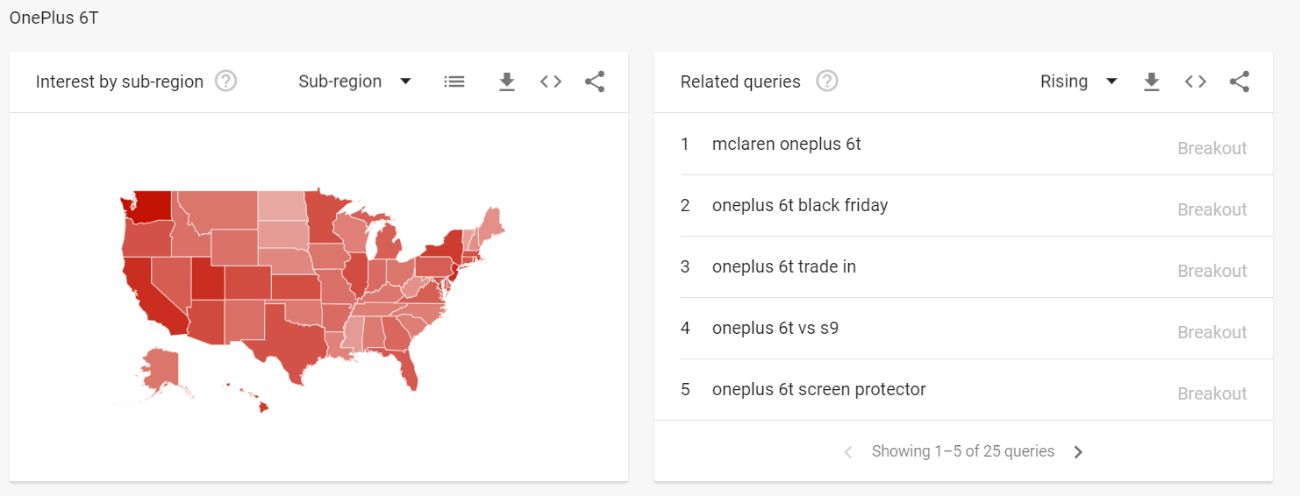
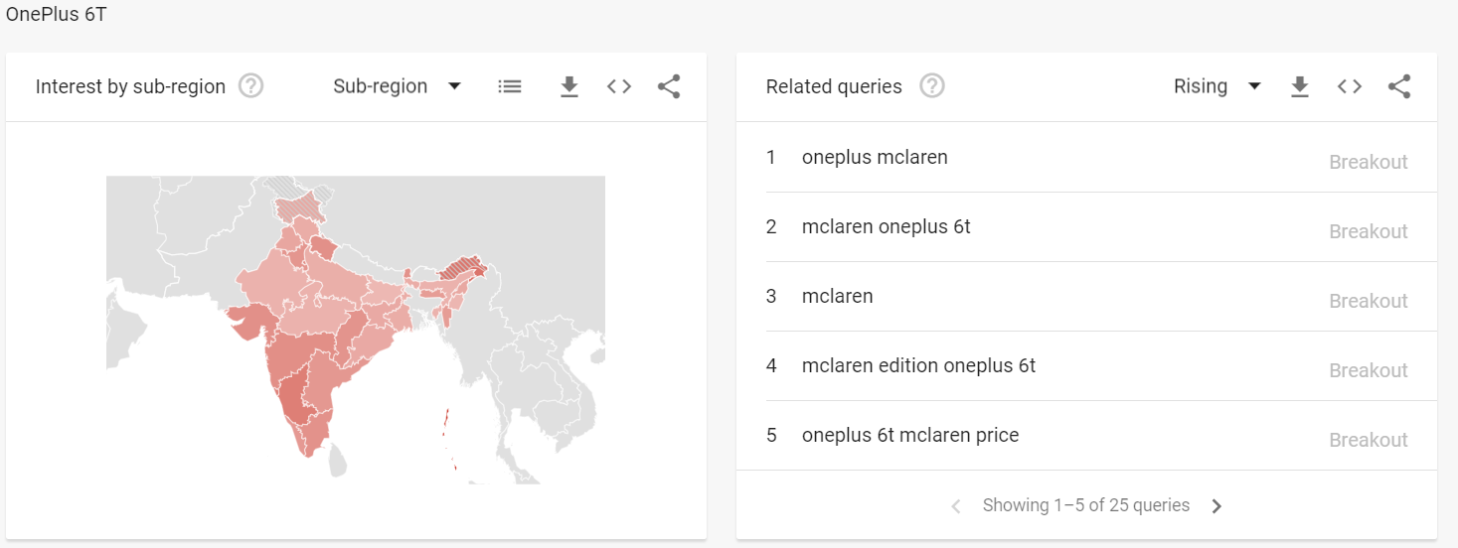
Google Trends

Slide 10
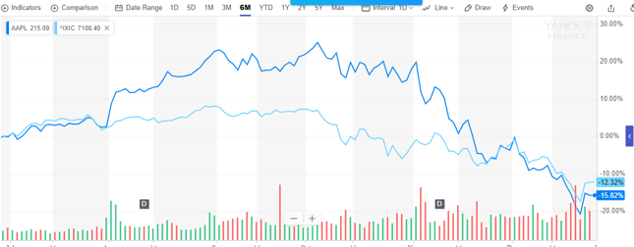
Conclusion
Overall with this analysis we were able to find that people have positive sentiment regarding iPhone X. Popularity of apple products most specifically iPhone is very good. There was a spike in Aug and Nov (4 days black Friday event). If we compare OnePlus 6T against iPhone X, iPhone is still a winner. This trend reverses in India where iPhone is not so popular against OnePlus or Samsung.
The overall Fan base in United States is still positive and are still Loyal towards Apple Products (Specially Apple iPhones)
Investor doesn’t show any decline in interest as Apple Stock Prices have similar movement as NSE. The only reason of decline is US-China Trade War and other global factors.
NSE and Apple Stock Prices

Slide 11

Demo Video
https://www.youtube.com/watch?v=rJOEY8iso78
Please refer to the below link for Database used in this Study
https://github.com/siwanian/PracticumData

